Slide 1
Black box Testing

Slide 2
Design of Test Cases
Exhaustive testing of any non-trivial system is impractical:
  input data domain is extremely large.
Design an optimal test suite:
  of reasonable size and
  uncovers as many errors as possible.

Slide 3
Design of Test Cases
If test cases are selected randomly:
  many test cases would not contribute to the significance of the test suite,
  would not detect errors not already being detected by other test cases in the suite.
Number of test cases in a randomly selected test suite:
  not an indication of effectiveness of testing.

Slide 4
Design of Test Cases
Testing a system using a large number of randomly selected test cases:
  does not mean that many errors in the system will be uncovered.
Consider an example for finding the maximum of two integers x and y.

Slide 5
Design of Test Cases
The code has a simple programming error:
If (x>y) max = x;
else max = x;
test suite {(x=3,y=2);(x=2,y=3)} can detect the error,
a larger test suite {(x=3,y=2);(x=4,y=3); (x=5,y=1)} does not detect the error.

Slide 6
Design of Test Cases
Systematic approaches are required to design an optimal test suite:
  each test case in the suite should detect different errors.

Slide 7
Design of Test Cases
There are essentially two main approaches to design test cases:
  Black-box approach
  White-box (or glass-box) approach

Slide 8
Black-box Testing
Test cases are designed using only functional specification of the software:
  without any knowledge of the internal structure of the software.
For this reason, black-box testing is also known as functional testing.

Slide 9
White-box Testing
Designing white-box test cases:
  requires knowledge about the internal structure of software.
  white-box testing is also called structural testing.
  In this unit we will not study white-box testing.

Slide 10
Black-box Testing
There are essentially two main approaches to design black box test cases:
  Equivalence class partitioning
  Boundary value analysis

Slide 11
Equivalence Class Partitioning
Input values to a program are partitioned into equivalence classes.
Partitioning is done such that:
  program behaves in similar ways to every input value belonging to an equivalence class.

Slide 12
Why define equivalence classes?
Test the code with just one representative value from each equivalence class:
  as good as testing using any other values from the equivalence classes.

Slide 13
Equivalence Class Partitioning
How do you determine the equivalence classes?
  examine the input data.
  few general guidelines for determining the equivalence classes can be given

Slide 14
Equivalence Class Partitioning
If the input data to the program is specified by a range of values:
  e.g. numbers between 1 to 5000.
  one valid and two invalid equivalence classes are defined.
1
5000

Slide 15
Example
A program reads an input value in the range of 1 and 5000:
  computes the square root of the input number
SQRT

Slide 16
Example (cont.)
There are three equivalence classes:
  the set of negative integers,
  set of integers in the range of 1 and 5000,
  integers larger than 5000.
1
5000

Slide 17
Example (cont.)
The test suite must include:
  representatives from each of the three equivalence classes:
  a possible test suite can be:
  {-5,500,6000}.
5000
1

Slide 18
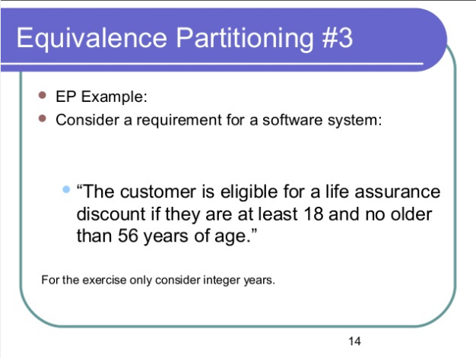


Slide 19
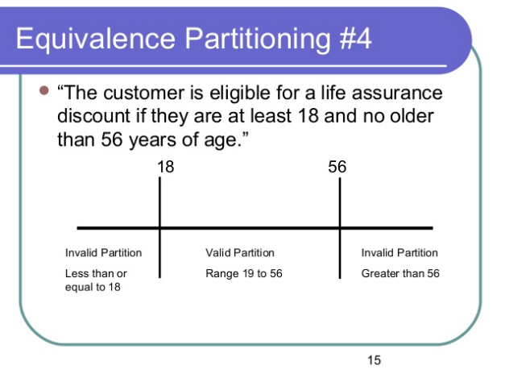

Slide 20
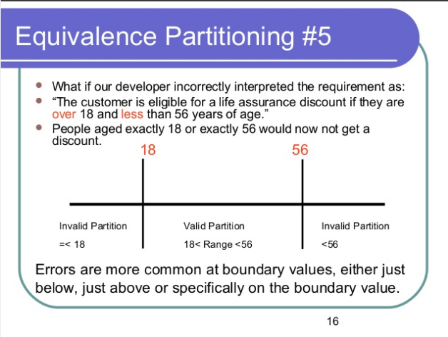

Slide 21
Boundary Value Analysis
Some typical programming errors occur:
  at boundaries of equivalence classes
  might be purely due to psychological factors.
Programmers often fail to see:
  special processing required at the boundaries of equivalence classes.

Slide 22
Boundary Value Analysis
Programmers may improperly use < instead of <=
Boundary value analysis:
  select test cases at the boundaries of different equivalence classes.

Slide 23
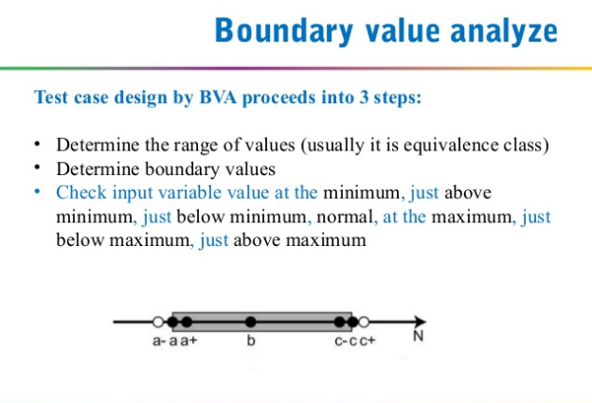

Slide 24
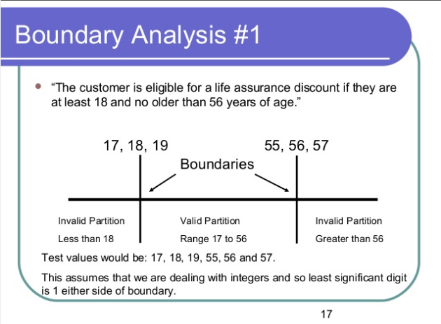

Slide 25
Example
For a function that computes the square root of an integer in the range of 1 and 5000:
  test cases must include the values: {0,1,5000,5001}.
1
5000

Slide 26
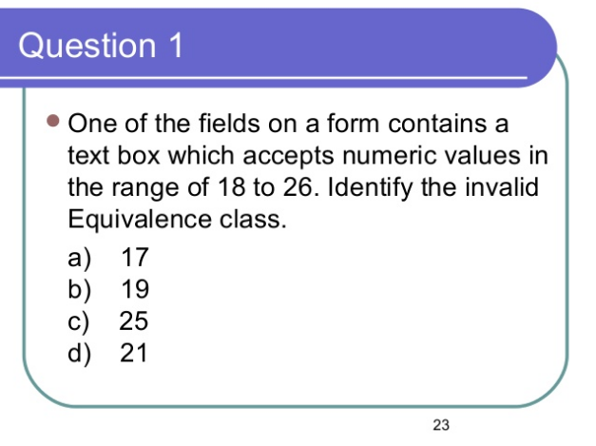

Slide 27
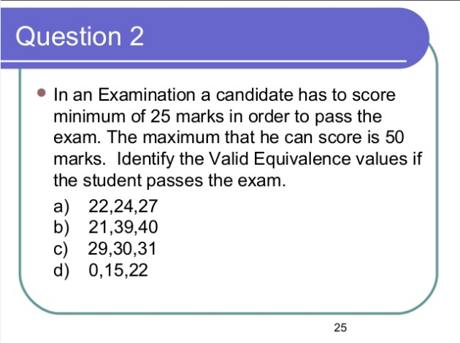

Slide 28
Performance Testing
Addresses non-functional requirements.
  May sometimes involve testing hardware and software together.
  There are several categories of performance testing.

Slide 29
Stress testing
Evaluates system performance
  when stressed for short periods of time.
Stress testing
  also known as endurance testing.

Slide 30
Stress testing
Stress tests are black box tests:
  designed to impose a range of abnormal and even illegal input conditions
  so as to stress the capabilities of the software.

Slide 31
Stress Testing
If the requirements is to handle a specified number of users, or devices:
  stress testing evaluates system performance when all users or devices are busy simultaneously.

Slide 32
Stress Testing
If an operating system is supposed to support 15 multiprogrammed jobs,
  the system is stressed by attempting to run 15 or more jobs simultaneously.
A real-time system might be tested
  to determine the effect of simultaneous arrival of several high-priority interrupts.

Slide 33
Volume Testing
Addresses handling large amounts of data in the system:
  whether data structures (e.g. queues, stacks, arrays, etc.) are large enough to handle all possible situations
  Fields, records, and files are stressed to check if their size can accommodate all possible data volumes.

Slide 34
Configuration Testing
Analyze system behavior:
  in various hardware and software configurations specified in the requirements
  sometimes systems are built in various configurations for different users
  for instance, a minimal system may serve a single user,
    other configurations for additional users.

Slide 35
Compatibility Testing
These tests are needed when the system interfaces with other systems:
  check whether the interface functions as required.

Slide 36
Compatibility testing
Example
If a system is to communicate with a large database system to retrieve information:
  a compatibility test examines speed and accuracy of retrieval.

Slide 37
Recovery Testing
These tests check response to:
  presence of faults or to the loss of data, power, devices, or services
  subject system to loss of resources
    check if the system recovers properly.

Slide 38
Maintenance Testing
Verify that:
  all required artifacts for maintenance exist
  they function properly

Slide 39
Documentation tests
Check that required documents exist and are consistent:
  user guides,
  maintenance guides,
  technical documents

Slide 40
Documentation tests
Sometimes requirements specify:
  format and audience of specific documents
  documents are evaluated for compliance

Slide 41
Usability tests
All aspects of user interfaces are tested:
  Display screens
  messages
  report formats
  navigation and selection problems

Slide 42
Regression Testing
Does not belong to either unit test, integration test, or system test.
  In stead, it is a separate dimension to these three forms of testing.

Slide 43
Regression testing
Regression testing is the running of test suite:
  after each change to the system or after each bug fix
  ensures that no new bug has been introduced due to the change or the bug fix.

Slide 44
Regression testing
Regression tests assure:
  the new system’s performance is at least as good as the old system
  always used during phased system development.

